Slide 1
Float Lecture Series
Intro to Web Design and Development

Slide 2
Day 2: Introducing Wordpress
Download the Software
Learn the Inspect Element Tool
Welcome to Wordpress
Coding Problems!
Edit Wordpress to do what YOU want

Slide 3
Download the Software

Slide 4



Download These Now
Mac: MAMP (mamp.info/en/downloads/)
PC: XAMPP (apachefriends.org/index.html)
Wordpress (wordpress.org)
Make sure to put Wordpress folder into MAMP/htdocs folder
Instructions to install:
MAMP: http://www.wpbeginner.com/wp-tutorials/how-to-install-wordpress-locally-on-mac-using-mamp/
XAMPP:
http://www.wikihow.com/Install-Wordpress-on-XAMPP
has Apache, MySQL, and PHP bundled into one package

Slide 5
Learn the Inspect Element Tool

Slide 6
While we’re waiting for MAMP/XAMPP to download...
Remember when we used “View Page Source” to get the code for a page?
You can right click -> “Inspect Element” on any element to get its code!

Slide 7
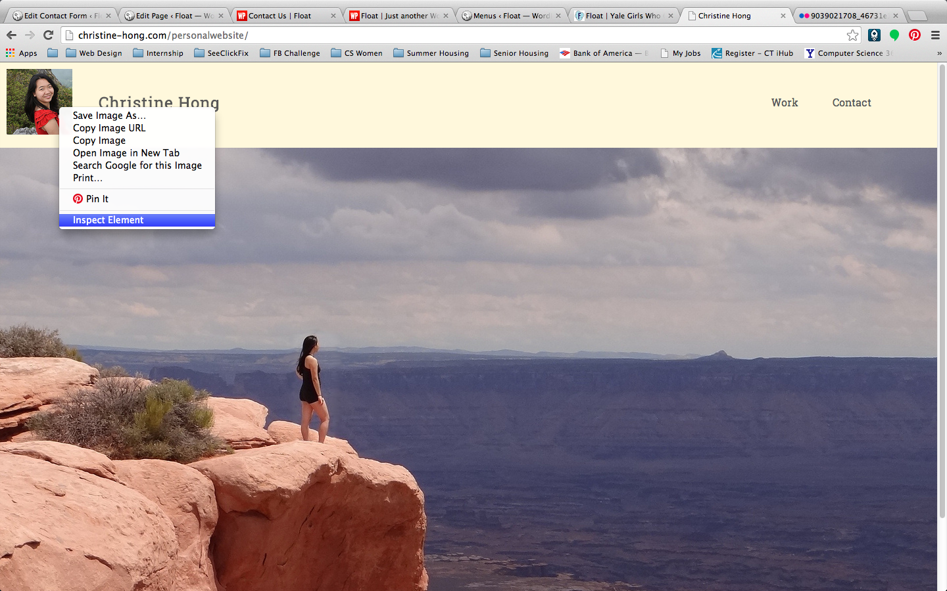
Example: Let’s figure out where my picture came from:
(christine-hong.com/personalwebsite)

Slide 8
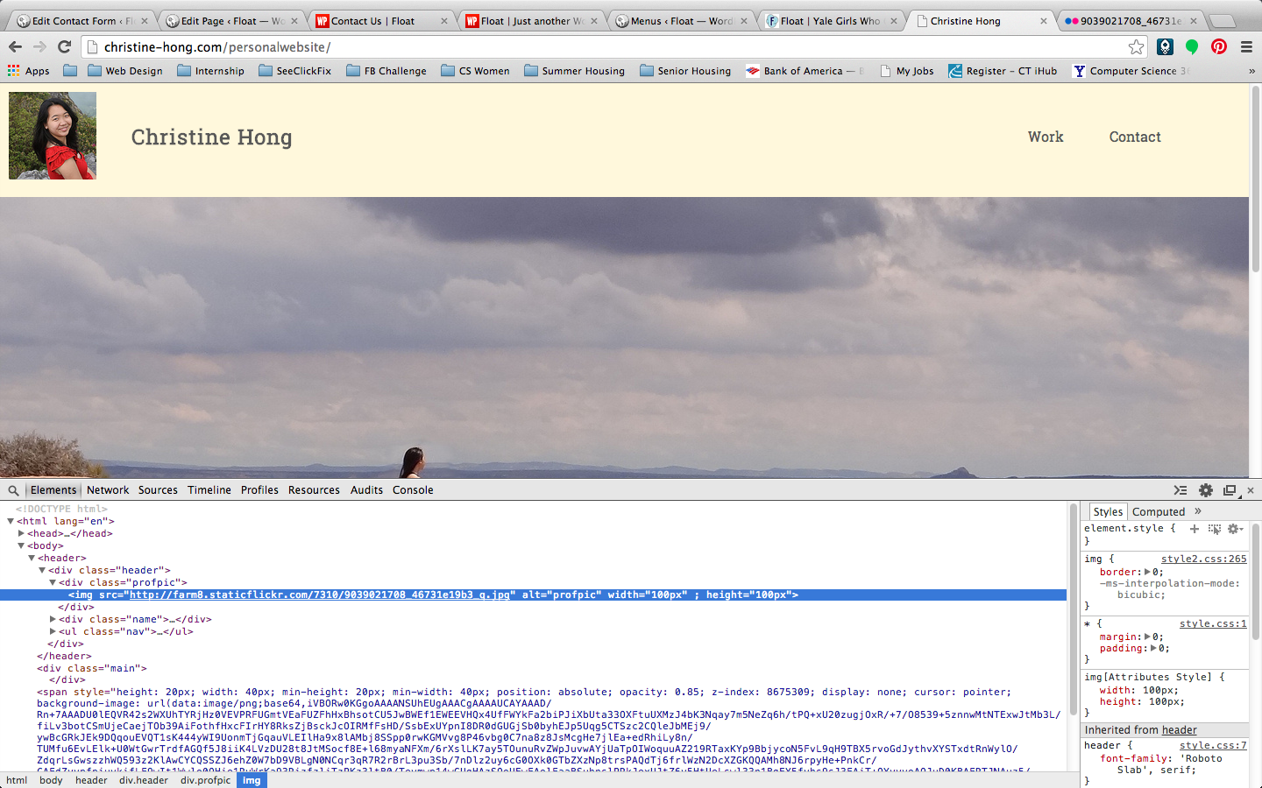
There’s my image source!

Slide 9
What’s the point of Inspect Element?
If you want to manipulate elements in a doc, you can easily see how they’re nested (their parents and siblings)
Also easy to grab classes/IDs of an element so you can manipulate it through CSS
Note: changing items in Inspect Element is for temporary view only (does not actually change saved code)

Slide 10
Welcome to Wordpress

Slide 11
First Steps
After you unzipped Wordpress folder, you’re done!
Each Wordpress Folder is one website
Make sure you started the MAMP server
Drag your unzipped Wordpress folder in MAMP/htdocs
rename Wordpress folder to “float”

Slide 12
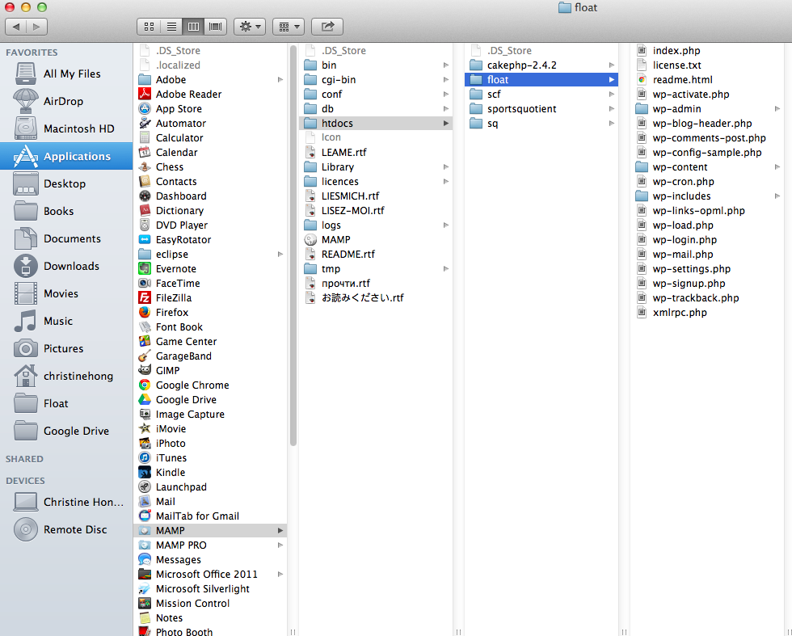
First Steps
Go to localhost/float to see preview of your site (if you change folder name, it’s localhost/folder-name)
Follow the configuration steps on the screen when you go to local host

Slide 13
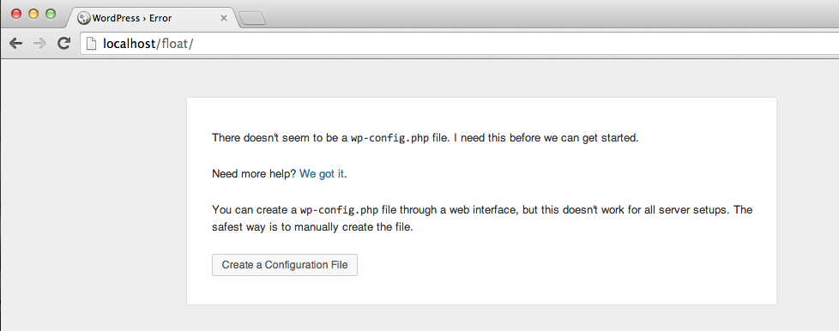
Configuring Wordpress

Slide 14
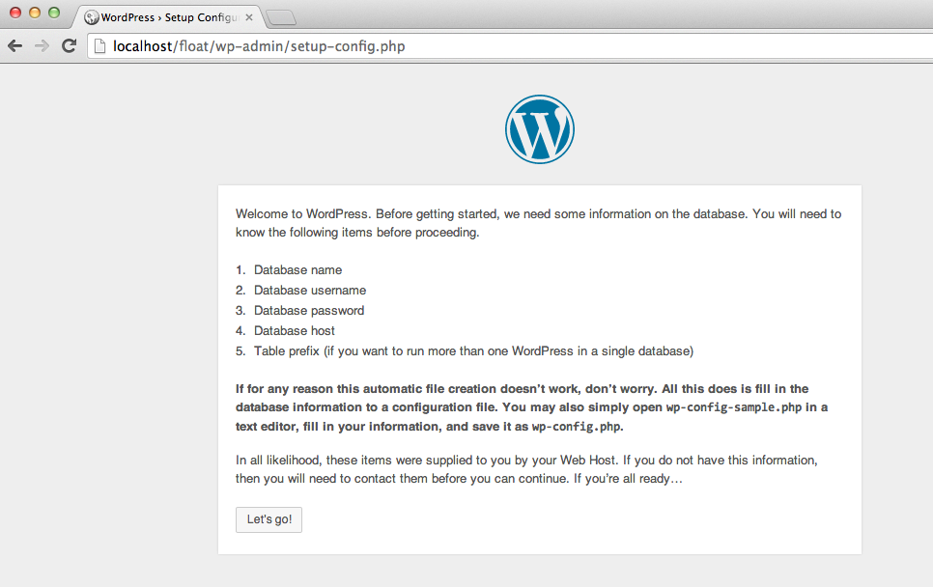

Slide 15
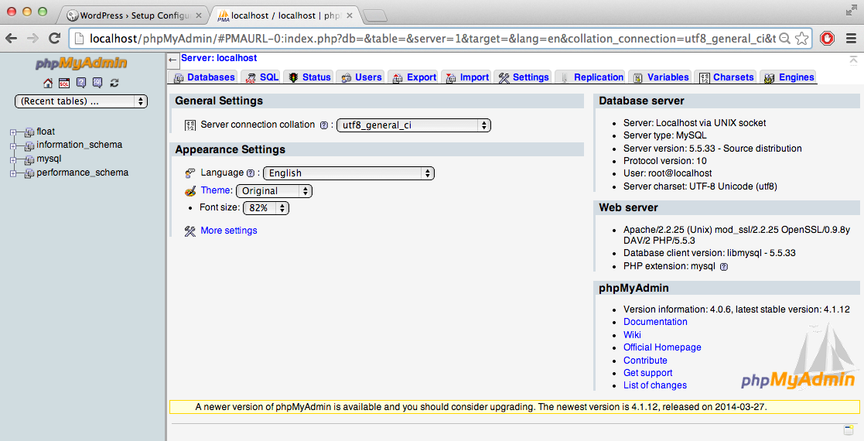
Creating Database
Go to: http://localhost/phpMyAdmin/
Click on the Databases tab

Slide 16
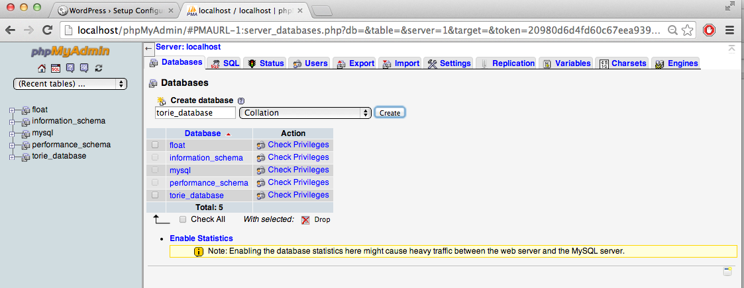
Name your database under “Create Database”
Keep Collation Tab, Click “Create” button

Slide 17
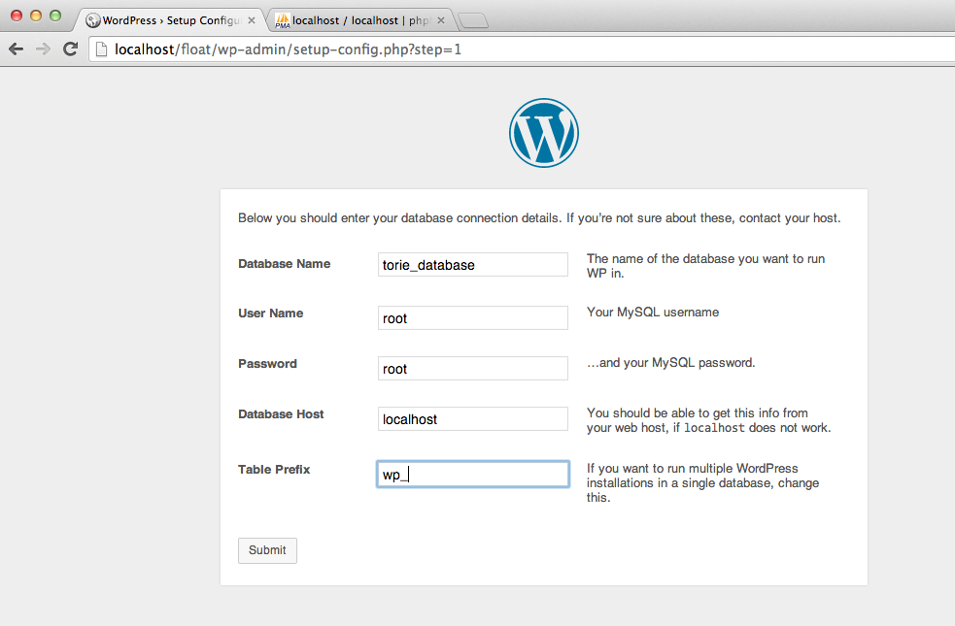
Link the database table you created to your Wordpress Site (go back to locahost/float)
Database Name: Enter the database name you created in your previous step
We’re using default username and password given by phpMyAdmin (can change at localhost/phpmyadmin)
User Name: root
Password: root
Database Host: localhost
Table Prefix: wp_

Slide 18
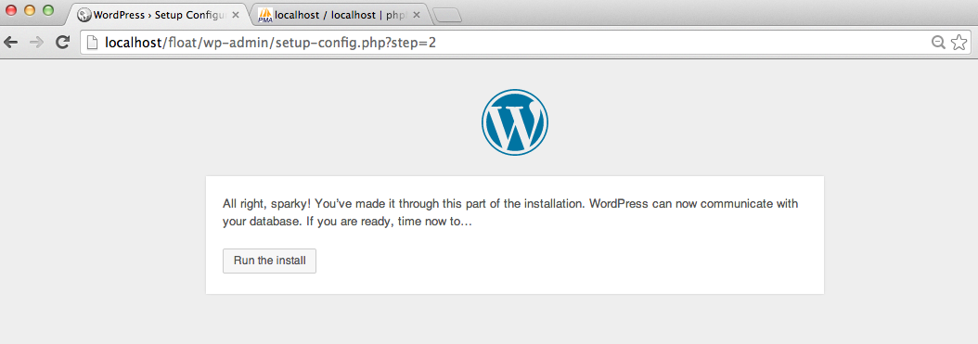
Great! Run the install

Slide 19
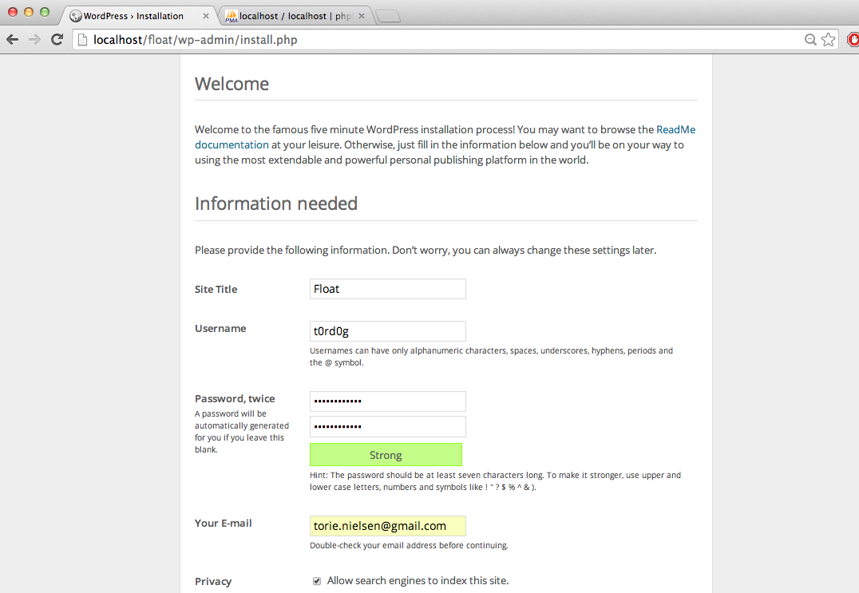
Setting up User Info
Enter whatever names/passwords you’d like for these fields (but make it less embarrassing than t0rd0g)

Slide 20
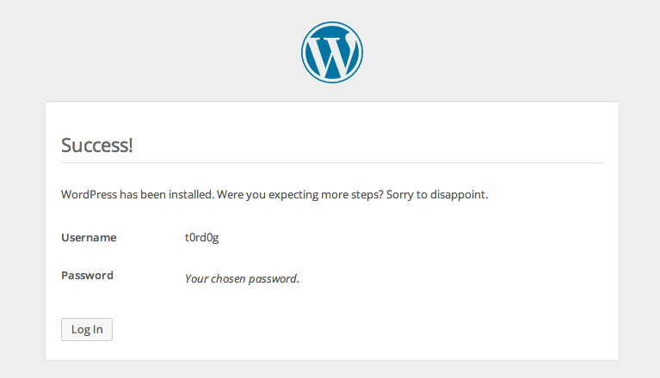
Success!

Slide 21
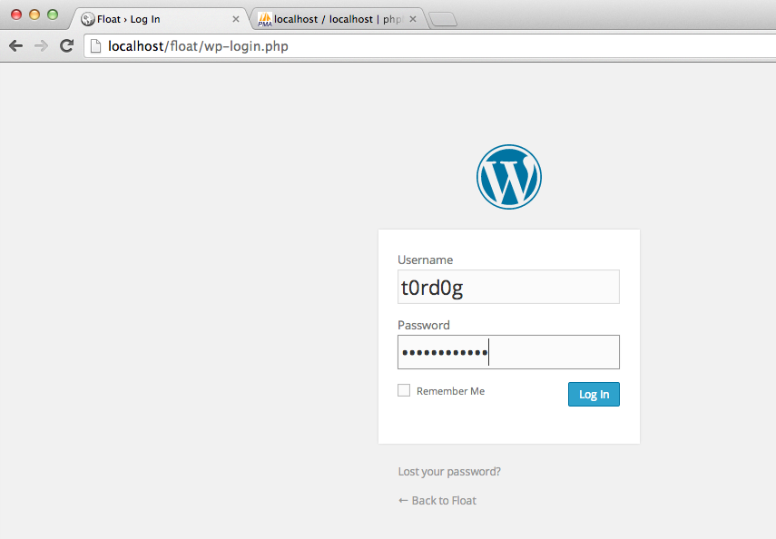
Url to login: localhost/float/wp-admin

Slide 22
Wordpress Dashboard

Slide 23
Best Wordpress Features
themes
makes site pretty (using CSS)
widgets
easily give site a sidebar
menus
easily give site a nav bar
plugins
lots of stuff (like adding contact form)
templates
change format of site page

Slide 24
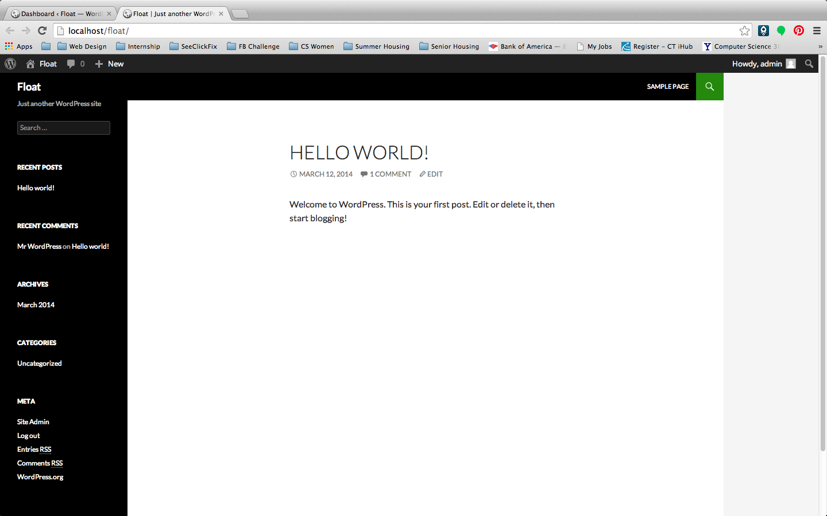
Basic Dashboard Look

Slide 25
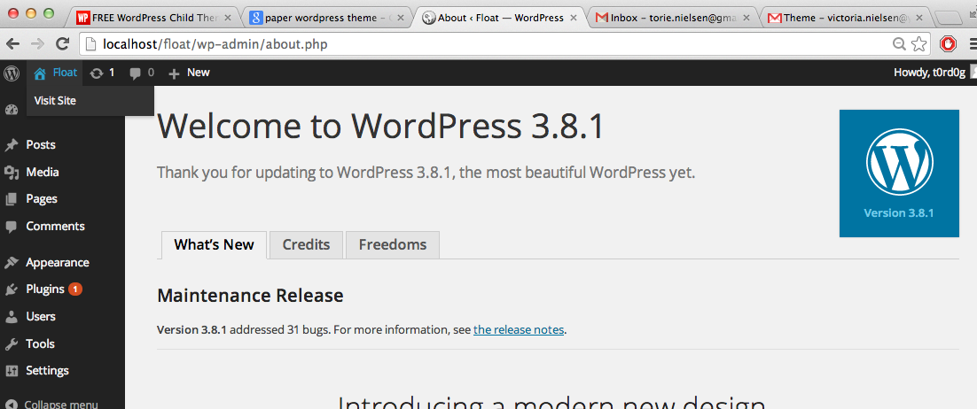
To View Your Website

Slide 26
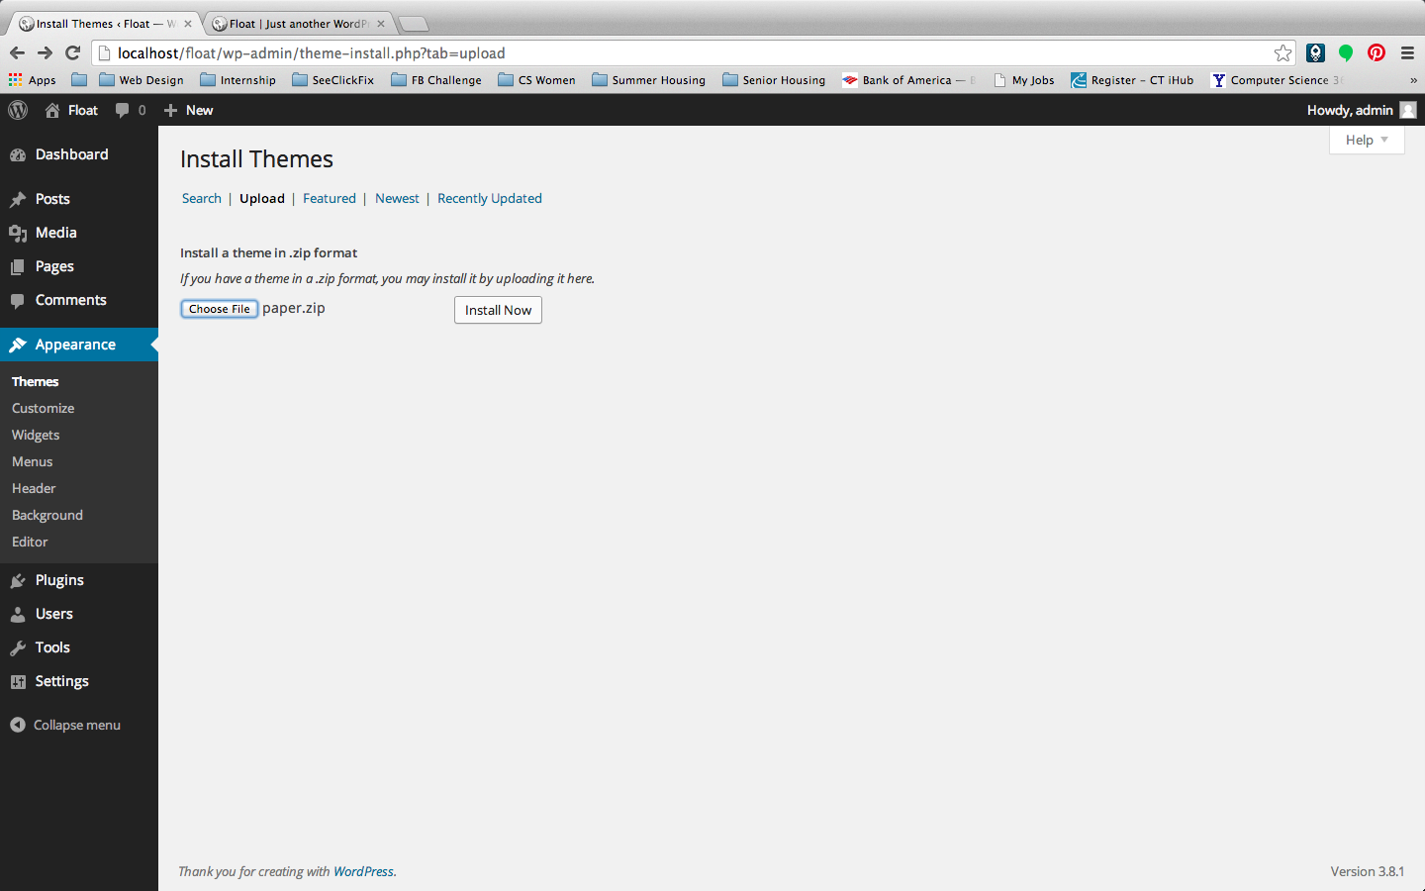
Themes
Type in “free wordpress theme” into Google and you’ll find a bunch
Make sure to upload a zip file (not unzipped) for the theme
Upload theme at Appearance -> Themes -> Add New Theme
Make sure to Activate it
(Float’s theme is at http://wpcharity.com/2011/08/17/free-wordpress-child-theme-for-twenty-eleven-paper/)

Slide 27
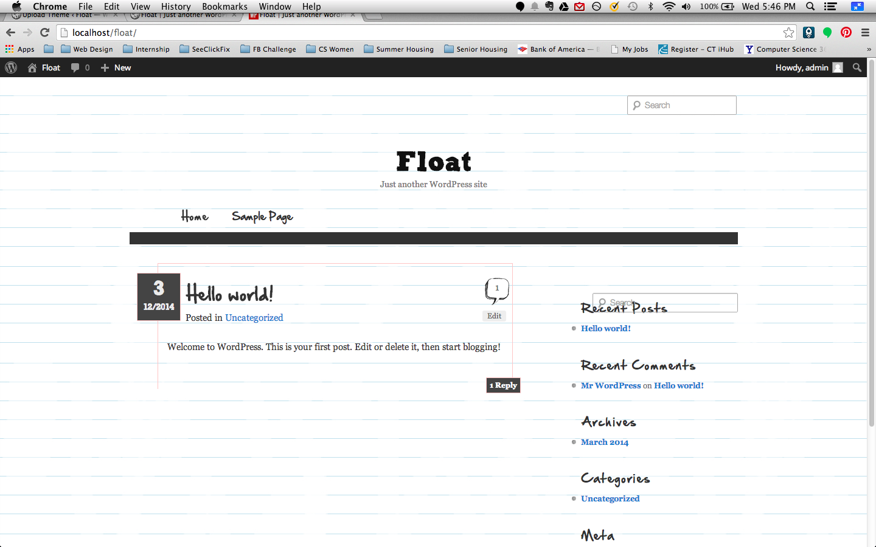
Voila!

Slide 28
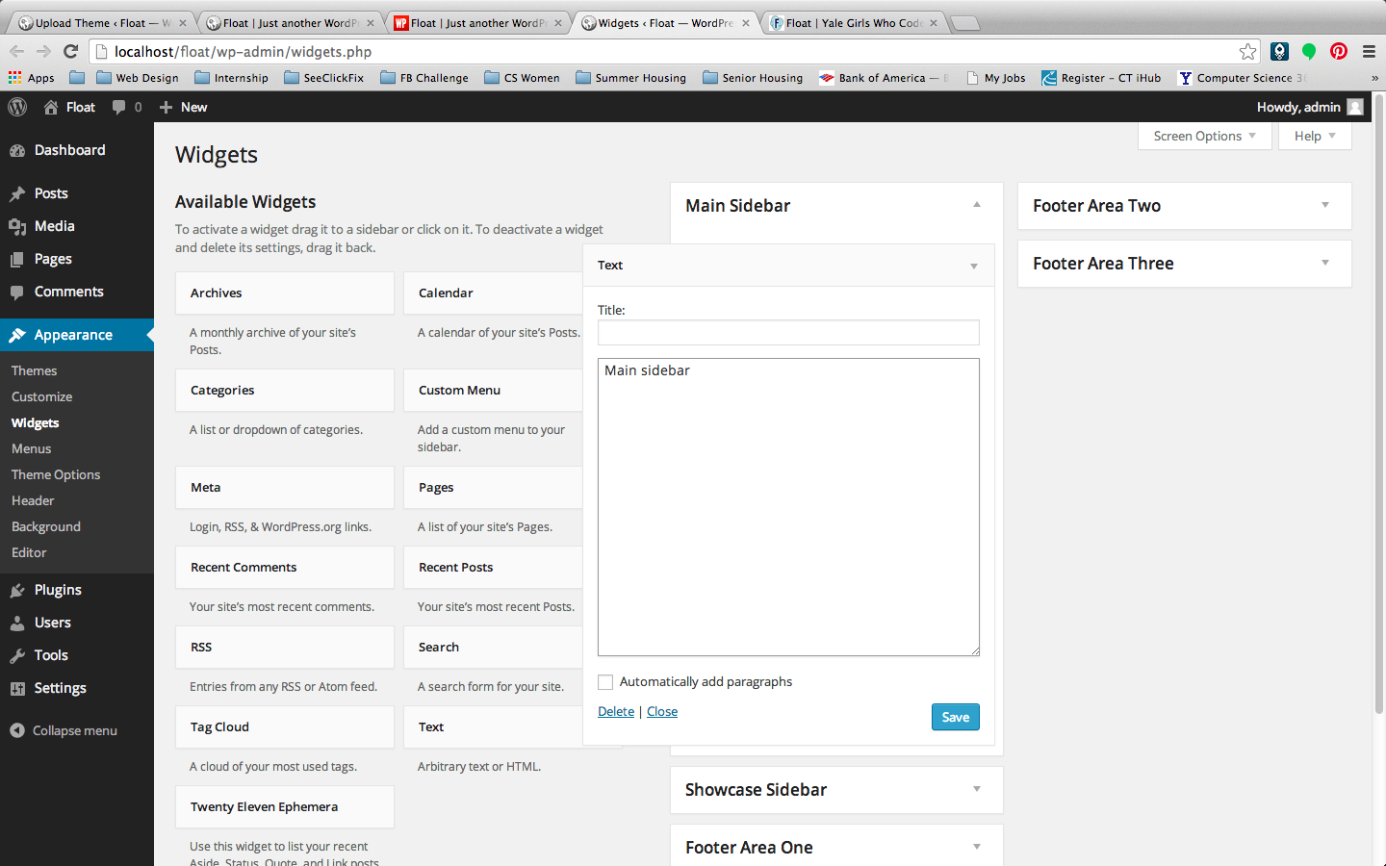
Widgets
Let’s you easily place stuff into sidebars, footer, etc.
Ex. We drag text that says “main sidebar”, “footer one”, “footer two” etc.

Slide 29
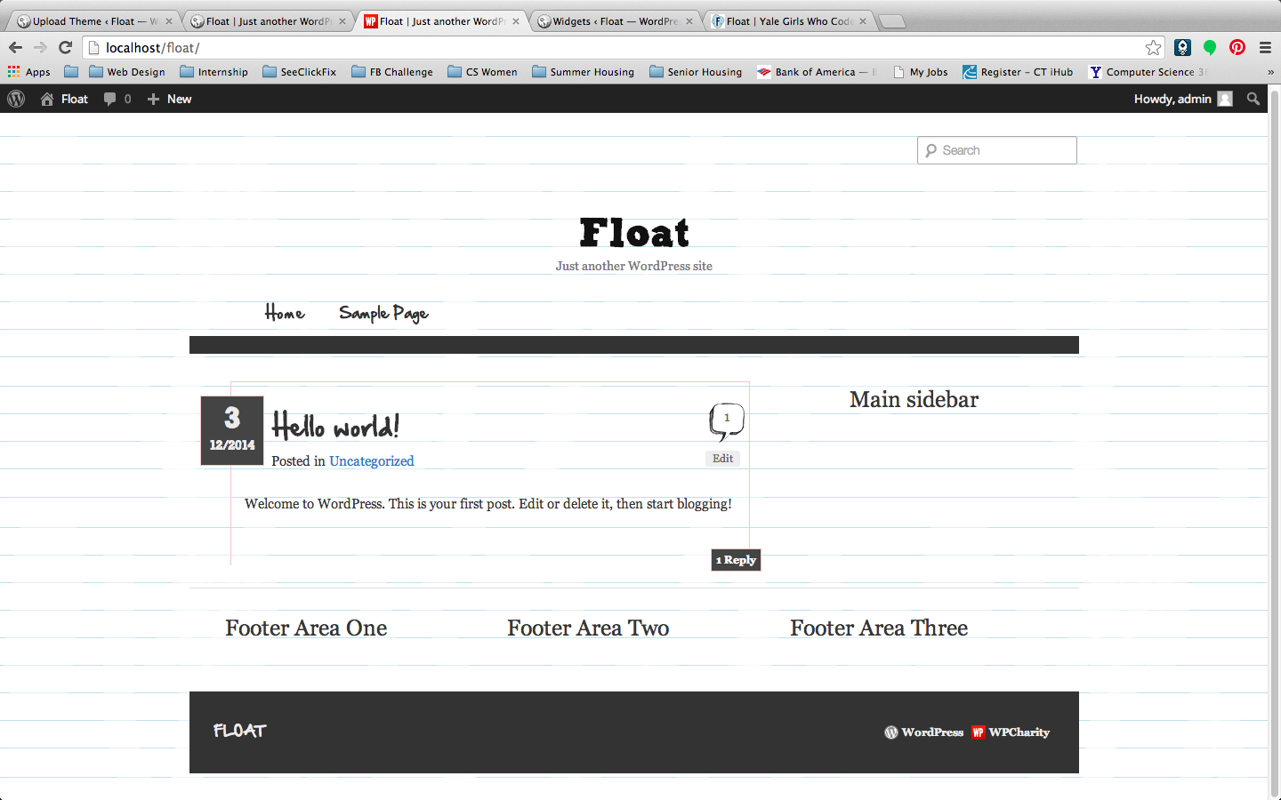
Voila!

Slide 30
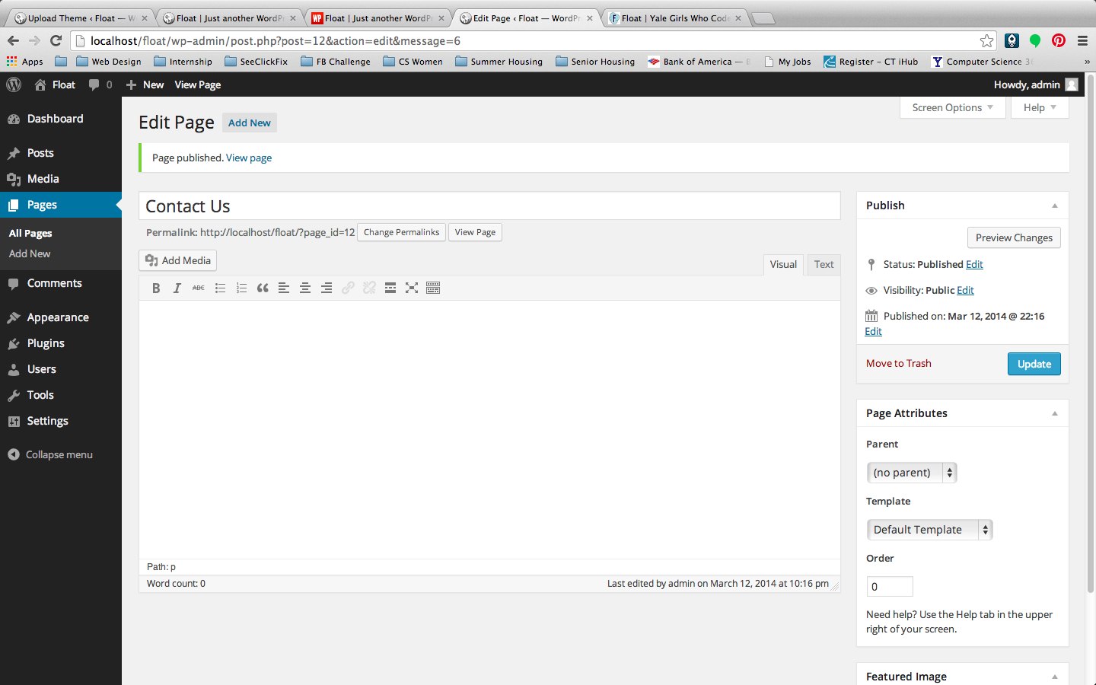
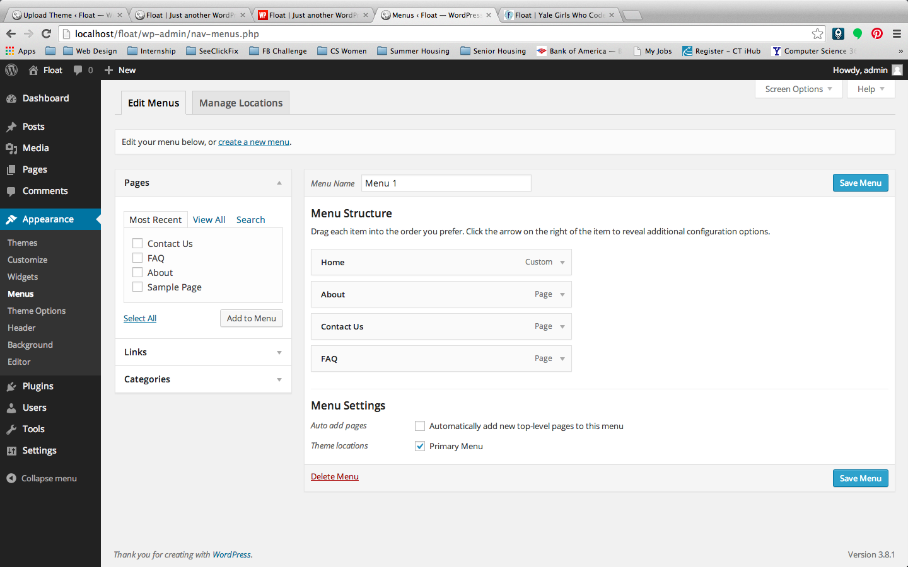
Menus
Let’s you change what is in each of the nav bars
Ex. We create blank pages named Home, About, FAQ, Contact Us and put them into menu.

Slide 31
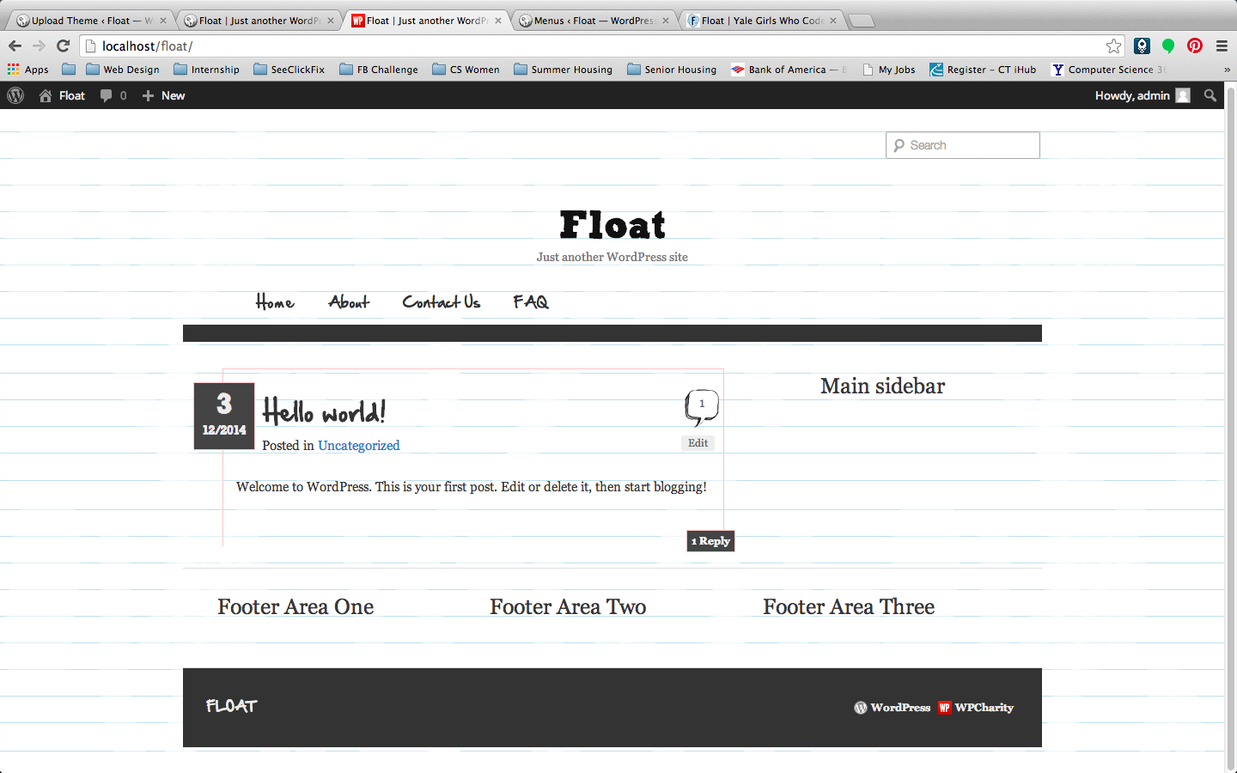
Voila!

Slide 32
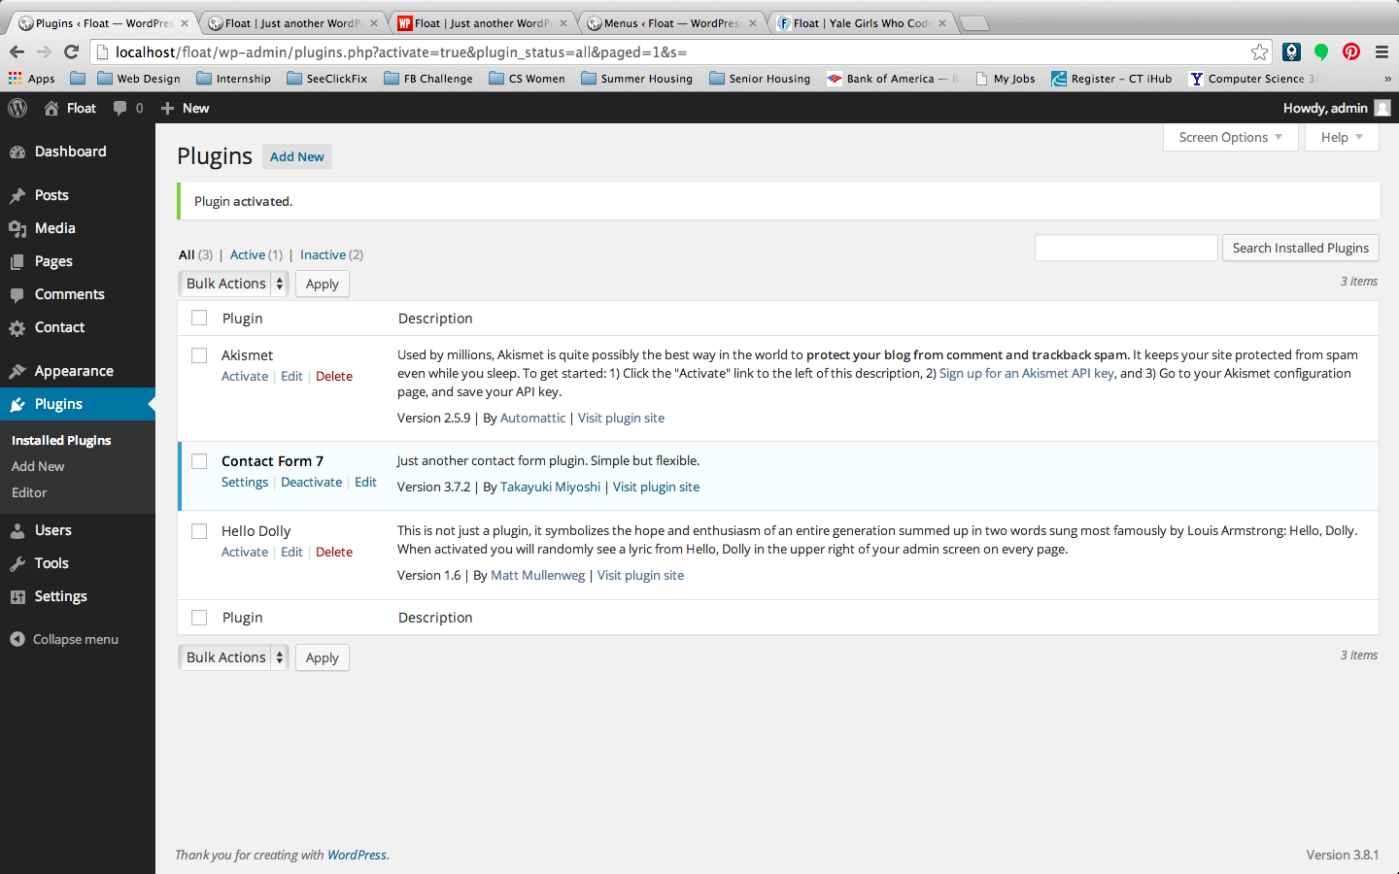
Plugins
There are tonsss of plugins that can make webdev way easier for you.
just google “wordpress plugin <feature I want>”
Ex. We will download a Contact Form 7 plugin

Slide 33
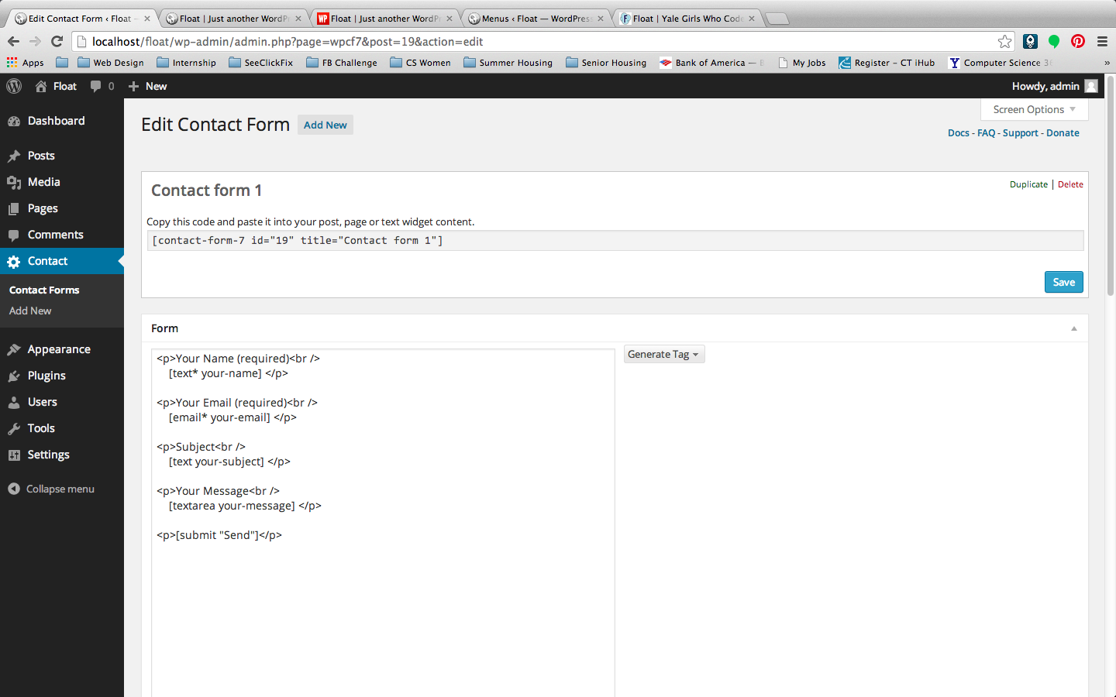
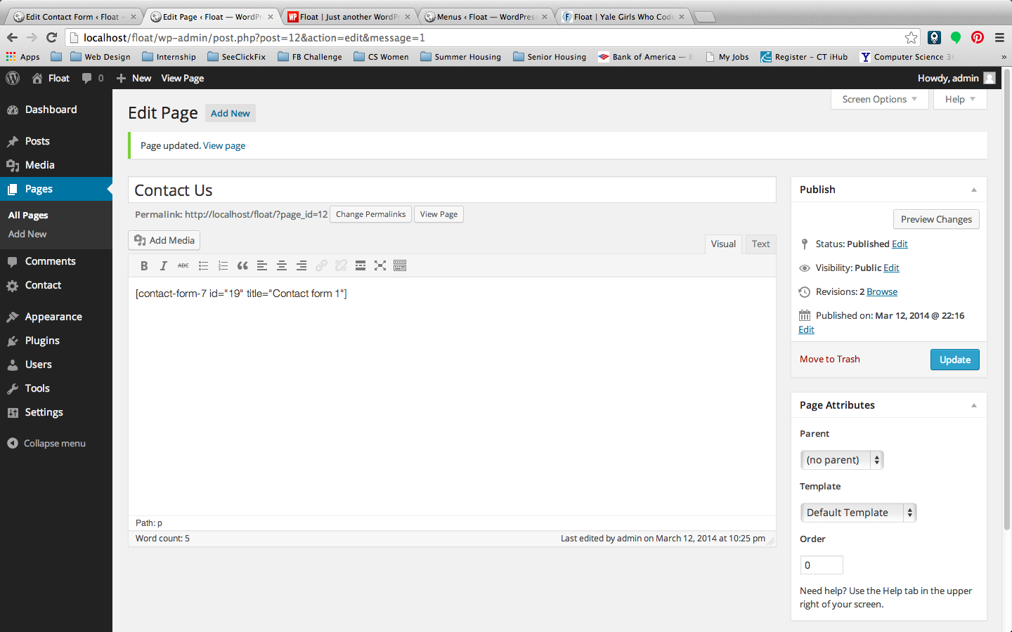
Setting Up Plugin
Just read plugin instructions to set it up
Wordpress shortcodes are useful, but don’t confuse this with real coding

Slide 34
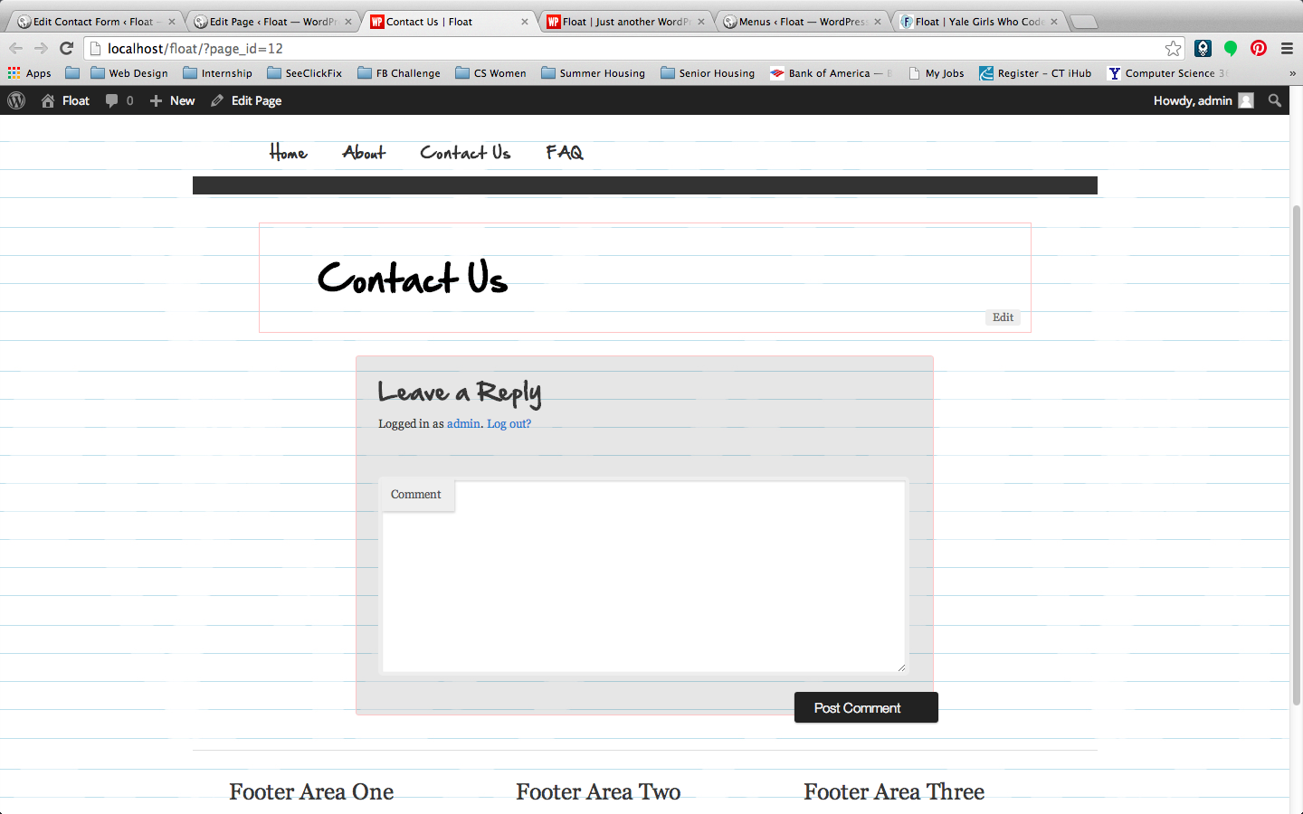
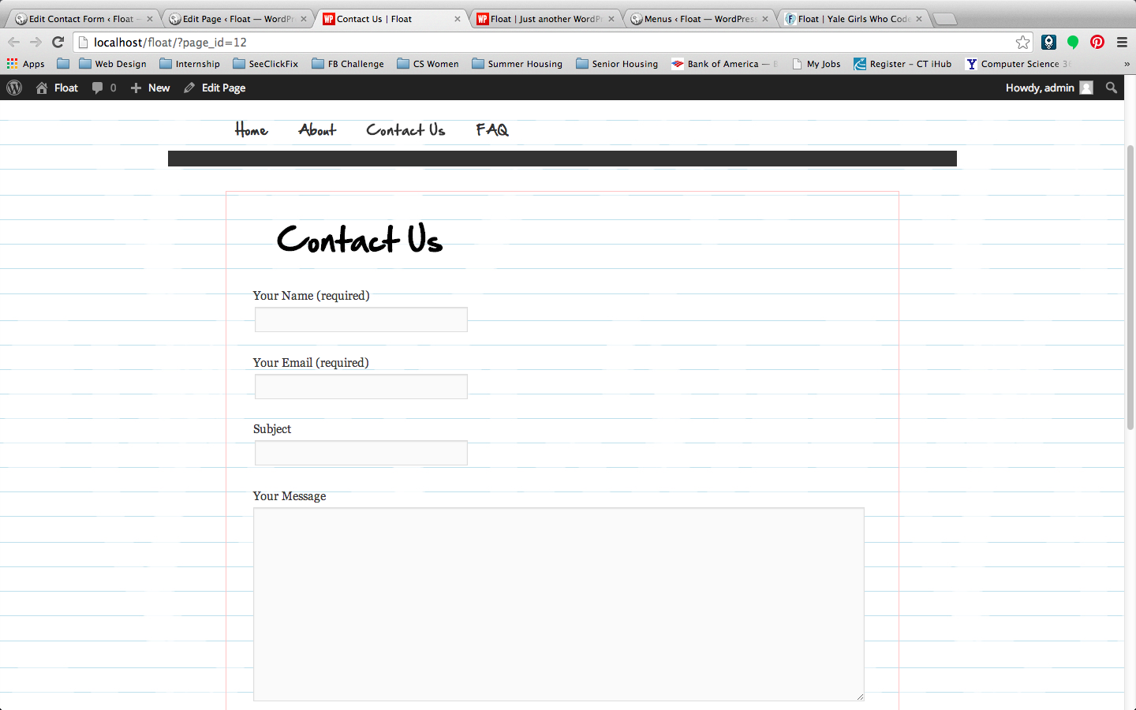
Voila!

Slide 35
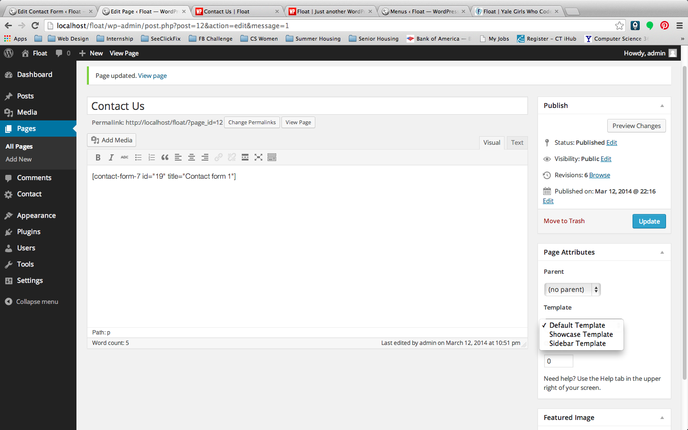
Templates
Each theme comes with certain useful templates
Ex. We want to change the “Contact Us” page to include the Sidebar, so we switch from “Default Template” to “Sidebar Template”
It is also relatively easy to code your own templates.

Slide 36
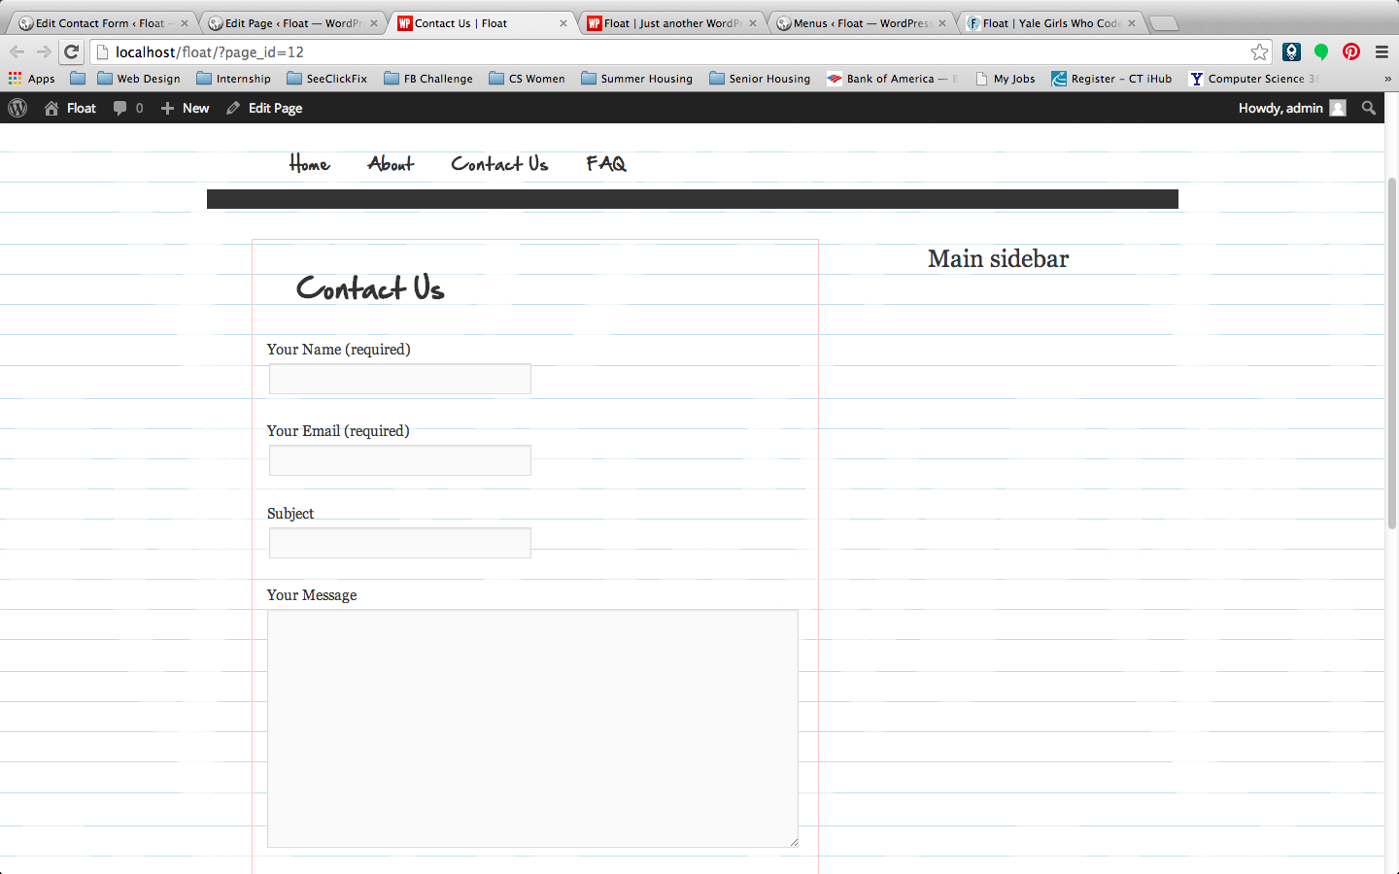
Voila!

Slide 37
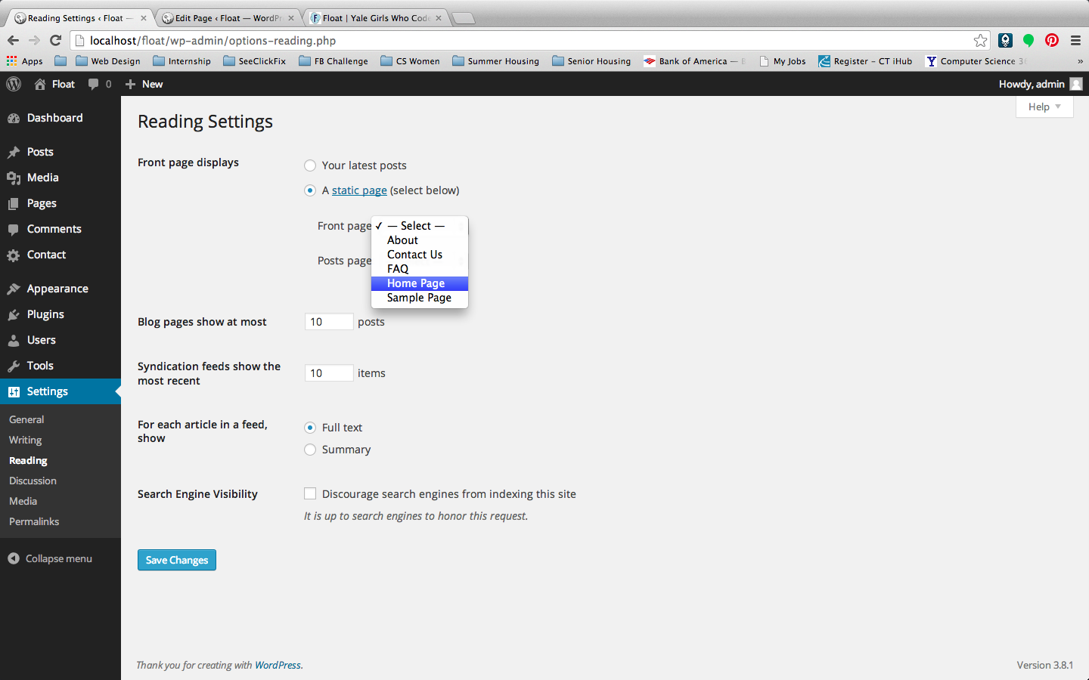
Additional Wordpress Features
Change home page from recent blog posts to static page

Slide 38
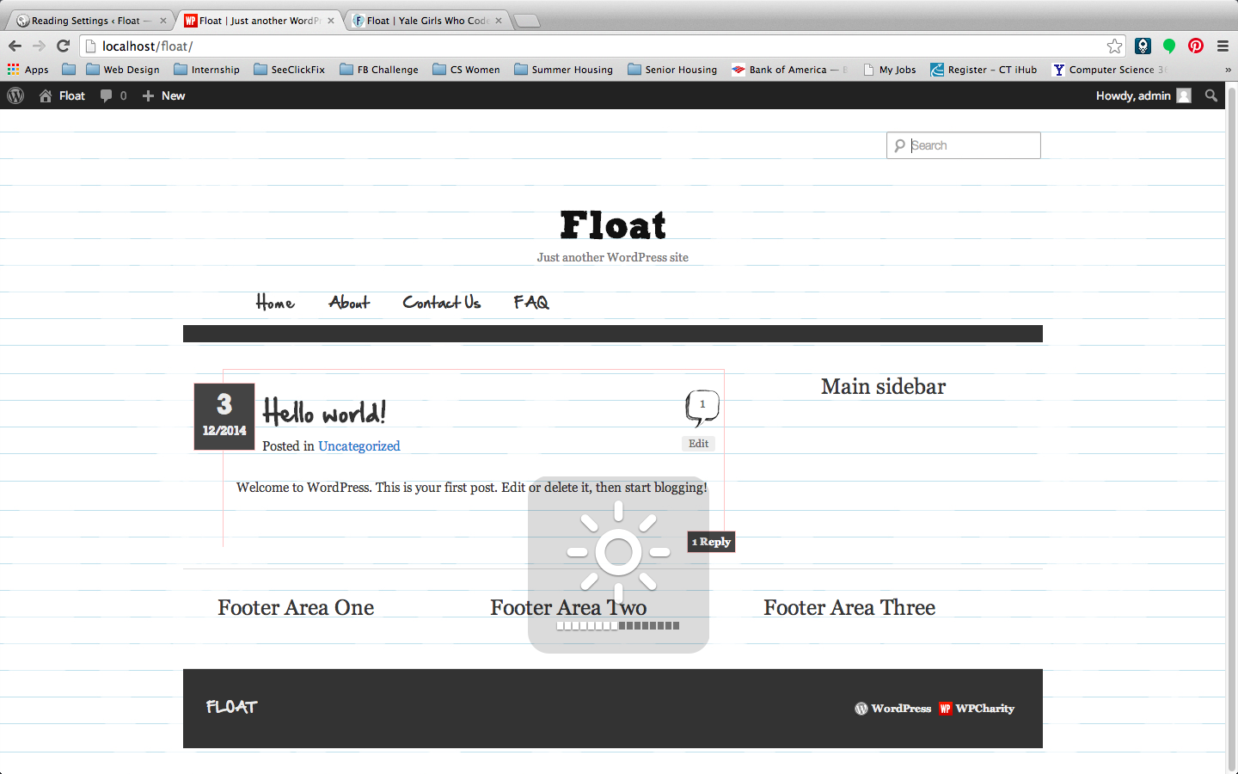
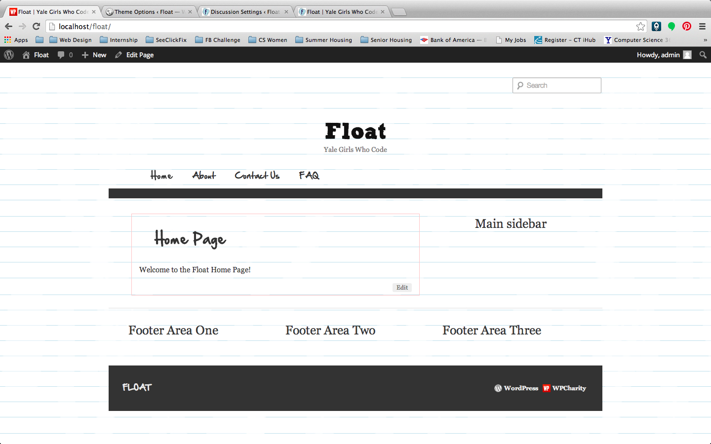
Voila!

Slide 39
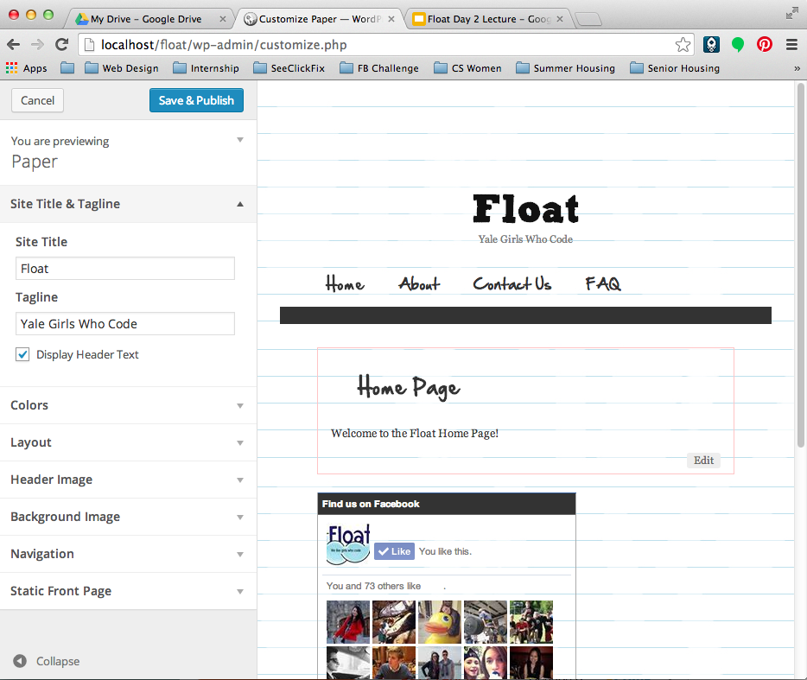
Additional Wordpress Features
Remove Website Title (Go to Appearance->Customize)

Slide 40
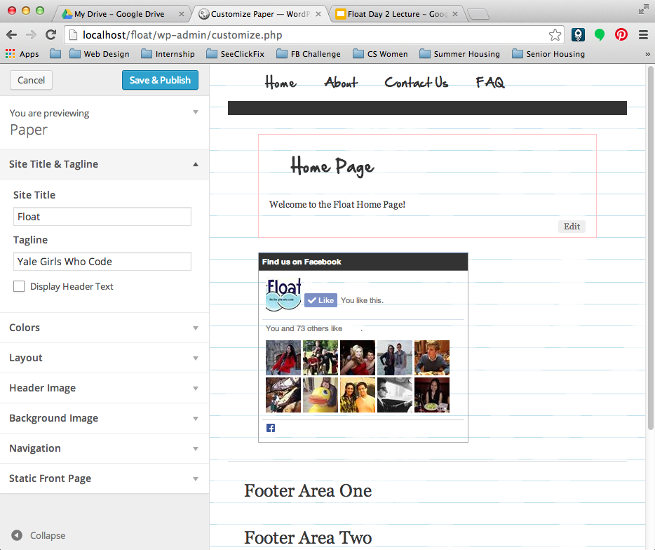
Voila!

Slide 41
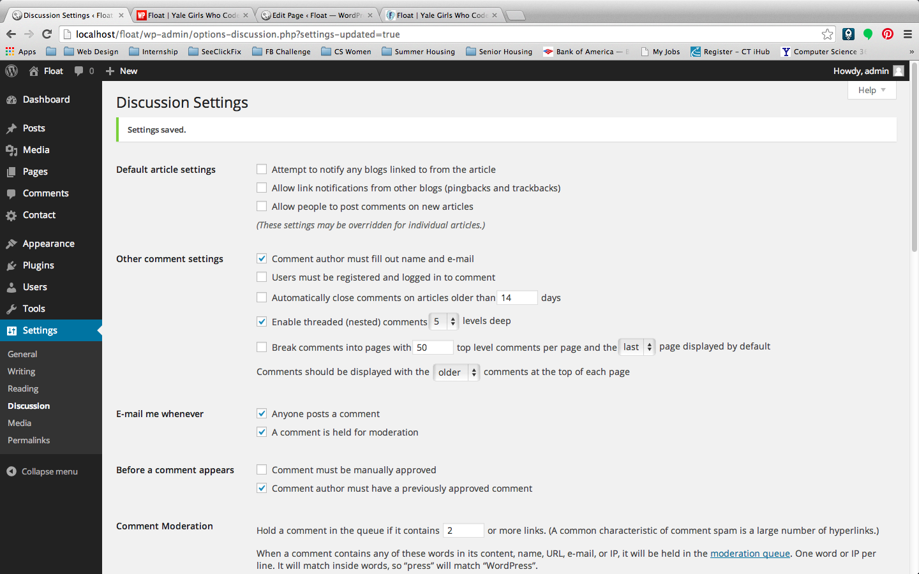
Additional Wordpress Features
Disabling comments

Slide 42

Additional Wordpress Features
Changing Permalinks
Ex. We changed our permalink from floatyale.com/?p=2 (second page created) to
floatyale.com/about
(name of page)
Change to Permalinks Custom Structure:
/%postname%/

Slide 43
Coding Problems
Let’s recreate Float’s website!

Slide 44
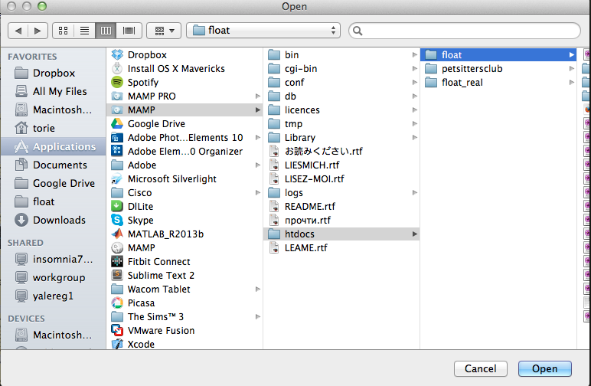
Before We Start
Open Sublime Text
File->Open
Navigate to your folder (ours is at Applications->MAMP->htdocs)
Make sure to click ONCE (not double click) on the folder, then Open

Slide 45
Tools To Use
Cmd-Shift-F is your friend.
It allows you to search through all the files in your folder for a specific keyword (if folder is opened on Sublime Text).
Cmd-T (It allows you to search a specific file in your folder. Ex. header.php)
Use the Inspect Element tool!

Slide 46
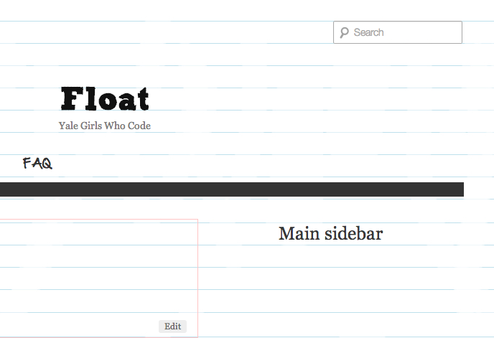
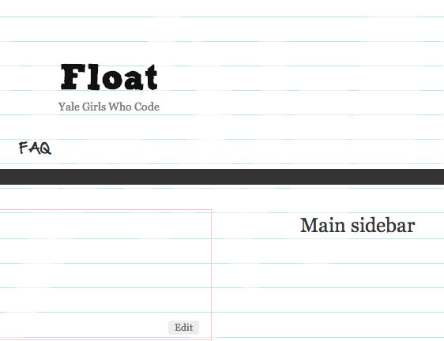
Problem 1
Hide that pesky search bar using CSS
Now
Want This

Slide 47
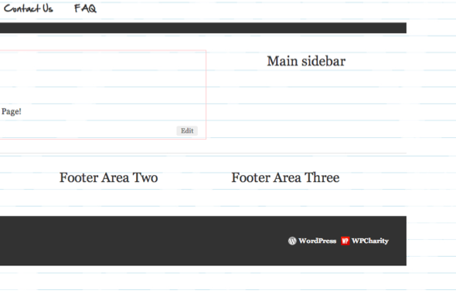
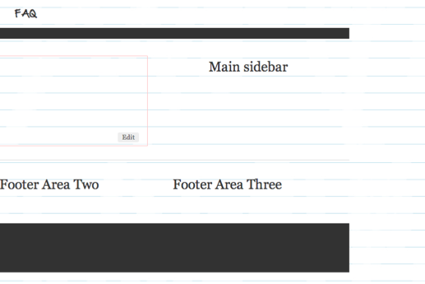
Problem 2
Hide the Wordpress Credit
Now
Want This

Slide 48
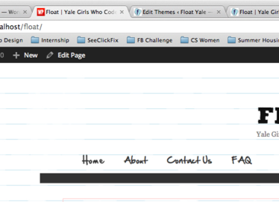
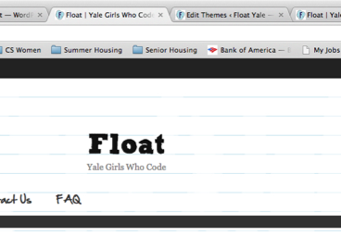
Problem 3
Change that Favicon
(Hint: search for the word “favicon” in your folder using Cmd-Shift-F)
Now
Want This

Slide 49
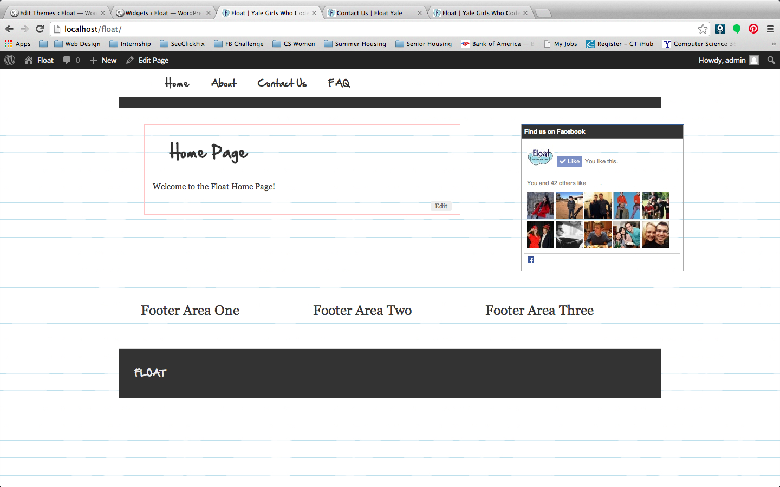
Problem 4
Add Facebook Like Box
(Hint: google “code for Facebook Like Box”)
Now
Want This

Slide 50
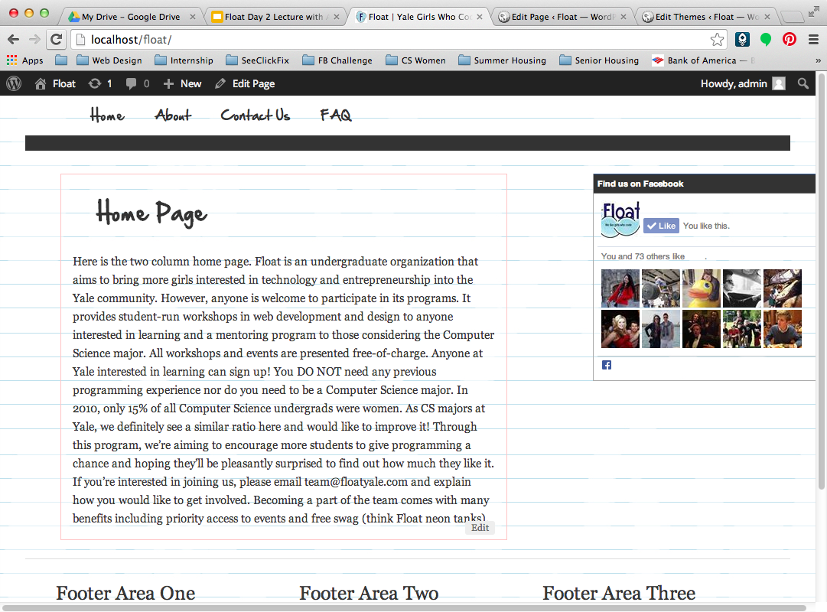
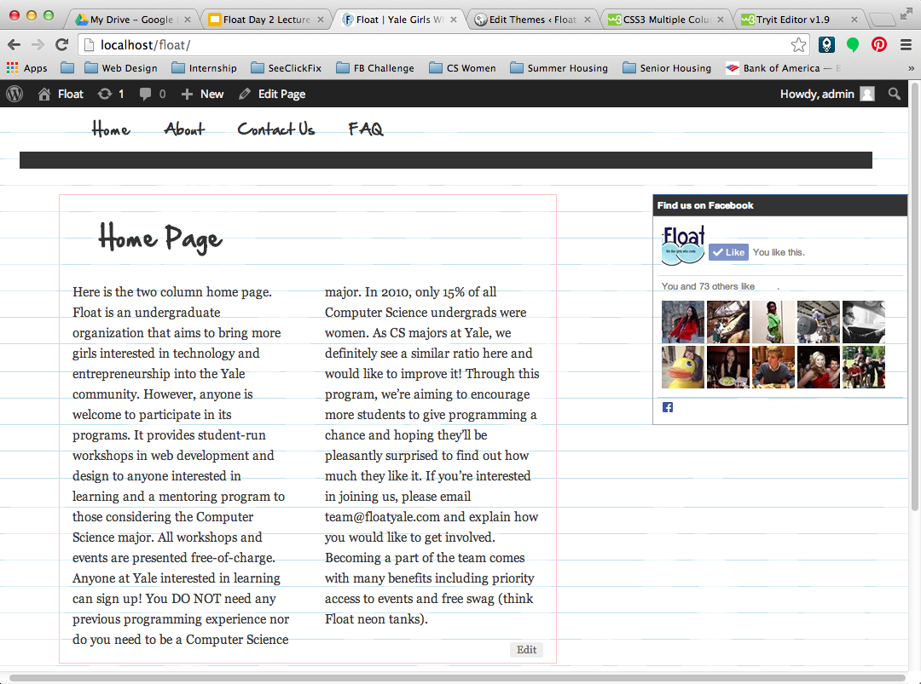
Problem 5
Make two column page
(Hint: add class to text in Page, style class in style.css)
Now
Want This

Slide 51
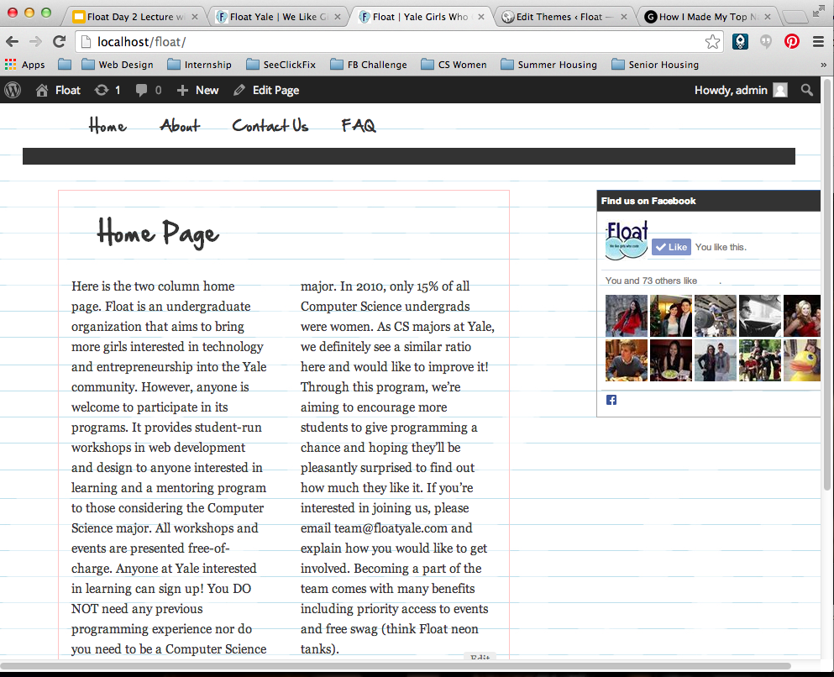
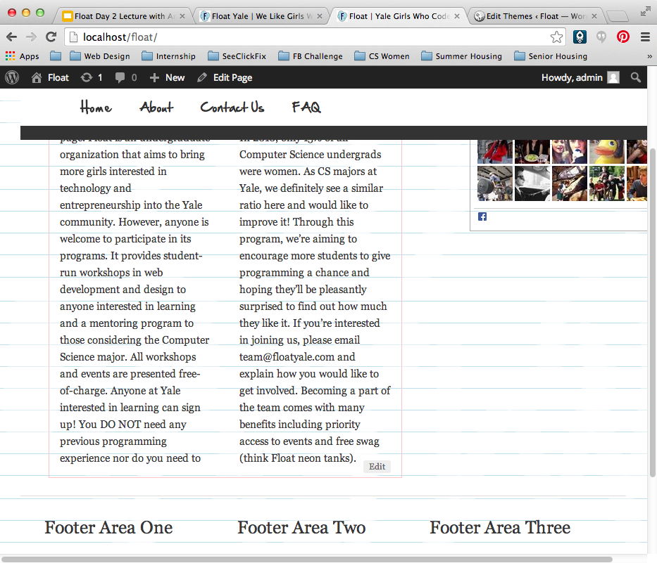
Problem 6
Make floating nav bar
(nav bar stays in place no matter what part of page you’ve scrolled to)
Hint: There are many ways to do this, opt for some simple CSS tricks

Slide 52
Edit Wordpress to do what YOU want

Slide 53
Time to make your own site now using Wordpress
Whatever site idea you had in application, make it now!
We’ll help you with any trouble you have and help you edit Wordpress to make it do what you want if you’re stuck

